Slide 1
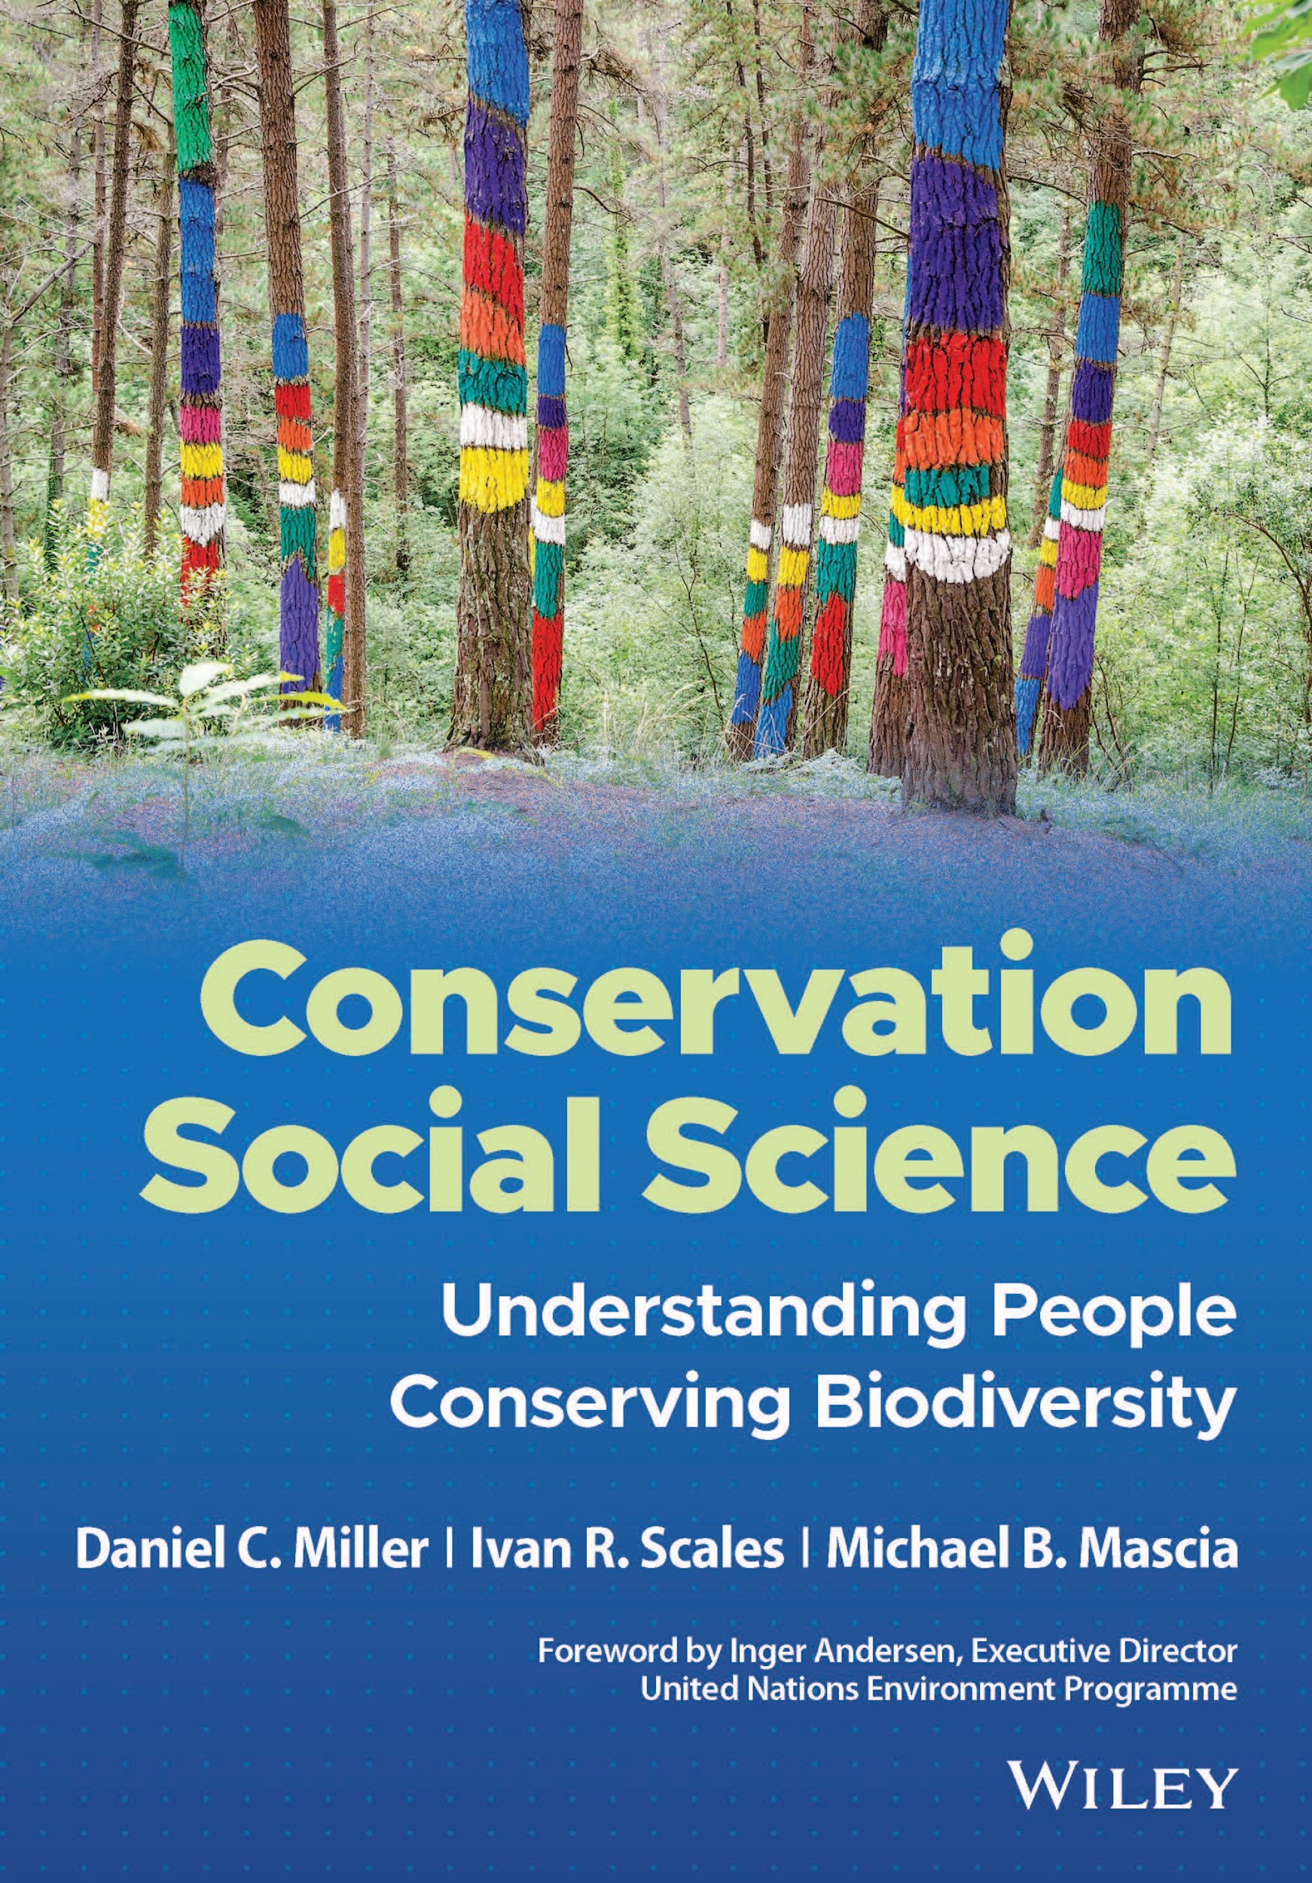
Companion slides for:
Ivan R. Scales and William M. Adams. “Human Geography and Conservation.” Chapter 5 in Conservation Social Science: Understanding People, Conserving Biodiversity, First Edition.
Daniel C. Miller, Ivan R. Scales, and Michael B. Mascia, Eds.
Published 2023 by John Wiley & Sons Ltd.
Companion websites:
https://www.conservationsocialscience.org/
https://bcs.wiley.com/he-bcs/Books?action=index&bcsId=12493&itemId=1444337572

Slide 2
Human Geography and Conservation
Chapter 5
Ivan R. Scales and William M. Adams

Slide 3
Chapter Overview
Defining Human Geography
A Brief History of Human Geography
Concepts, Approaches, and Areas of Inquiry in Human Geography
Future Directions

Slide 4
I. Defining Human Geography

Slide 5
Definition
Geography: The study of Earth's surface and human-environment interactions
  Geo: Earth, land, or soil
  Grapho: To write, draw, or describe
Purpose of Geography:
  Describe the face of the Earth
  Account for humanity's impact on Earth

Slide 6
Definition Continued
Geography combines physical and human aspects
Physical Geography: focuses on Earth's surface processes
  Geomorphology, Hydrology, Pedology, Meteorology, Biogeography
Human Geography: focuses on social, economic, political, and cultural processes
  Study of spatial organization of human activity
  Relationship between people and their environments
Spatial Levels in Human Geography:
  Individuals, households, regions, nations, and the planet
  Qualitative and quantitative research methods

Slide 7
II. A Brief History of Human Geography

Slide 8
Brief History of Geography
Dates back to the nineteenth century
Geography societies in Longdon, New York, Edinburgh, Paris, Berlin
Frank Debenham (1883-1965)
Natural history’s emphasis on fieldwork
1950s geography “quantitative revolution”
Human geography reinvented as a spatial science

Slide 9
History of Geography: 1970s
Scientific analysis at the center of geographic theory
Radical human geographers push for more theoretical understanding and social relevance
New approaches:
  Epistemological and ideological issues
  Marxism
  Development studies
  Social and environmental impacts of capitalism
  Humanistic approaches

Slide 10
History of Geography: 1980s-present
Postmodern social theory, post-structuralist thought
Understanding of space engaged with philosophical thought
1990s: Henri Lefebvre
  Perceived space
  Conceived space
  Lived space
Space is produced by human interactions
21st century: diversity and dynamism of the discipline

Slide 11
III. Concepts, Approaches, and Areas of Inquiry in Human Geography

Slide 12
Space
Geometric Notions of Space:
  Describing and analyzing locations of events and phenomena
  Three-dimensional grid for locating objects and events
1950s onwards: Geometry-based understanding of space
  Basis for systematic academic agenda in geography
  Importance in cartography and Geographic Information Systems (GISs)
Social Construction of Space:
  Shift in focus among human geographers
  Space as socially constructed, perceived, and imagined
  Space shaped by political and social processes
  Questions of power and knowledge in relation to space

Slide 13
Place (1/2)
Understanding Place:
  Definition: A portion of geographic space
  Tradition of identifying discrete spatial units (e.g., regions)
Differences in Places:
  Fundamental observation: Places are different from each other
  Influence of factors such as geology, soils, ecology, history, economy, culture, and politics
  Importance of place at various scales

Slide 14
Place (2/2)
Social Construction of Place:
  Place as a socially constructed concept
  Creation of places by analysts (geographers or local citizens)
  Cultural "sense of place," maps, and territorial jurisdiction are social and political factors

Slide 15
Human Geography and Conservation
Vocabulary of conservation filled with spatial terms
  Examples: protected areas, ecoregions, biodiversity hotspots, buffer zones, wildlife corridors
Spatial tools for mapping biodiversity and identifying threats

Slide 16
Questions important to Conservation
Ideas of Nature and Place
Concern for the environment and support for conservation varies between different places—why is this?
How do different people understand nature and how do these understandings influence the way nature is used?

Slide 17
Questions important to Conservation
Nature and Society
What factors determine where human impacts on natural habitat are most significant, and what causes these impacts to grow, persist, or decline?
Where, why, and how can economic growth contribute to sustained improvements in human well-being without environmental degradation?
What is the relationship between wealth and environmental degradation? For example, how does national income relate to ecological footprint?

Slide 18
Questions important to Conservation
The Control of Nature
How does the way nature is classified and measured affect its conservation?
Where is the social impact of conservation likely to be positive and where negative, and why is this?
How do different political and economic systems affect biodiversity?

Slide 19
IV. Future Decisions

Slide 20
Geography and the Importance of Place in Conservation
Conservation occurs in specific places, influenced by social and material factors.
  Space and place exploration are crucial for understanding events
Biodiversity threats are context-specific, requiring case studies and fieldwork
Geography embraces tensions:
  Physical vs. human
  Universal laws vs. unique descriptions
  Quantitative vs. qualitative
  Positivists vs. constructivists

Slide 21
Power, Scale, and Justice in Conservation
Scale matters: deeper drivers influence human-environment interactions
Power dynamics and knowledge production are central to conservation
Conservation intersects with development and justice, needing research on economic growth, poverty, and resource use
Reflexivity is crucial, considering values, theories, narratives, politics, and realities

